Slide 1
The Insurance Authority
Medical Insurance from a Regulatory Perspective
Dubai 2020

Slide 2
Where do we stand?
UAE insurance market ranked No. (1) over the MENA Region during the last (10) years, making progress on annual basis in the global ranking reaching No. (37) globally, and moving forward.
Written premium reached AED 43.7 billion in 2018, and the results for 2019 indicate continued growth.

Slide 3
Medical Insurance Statistics:
50 insurance companies underwrite medical (life, non-life & composite).
TPA (21).
Total premiums written in medical insurance: AED 19.1 billion, equivalent to 44% of the total premiums written to the insurance sector amounting to AED 43.7 billion.
Claims paid in Medical Insurance: (15.1) billion dirhams.
Loss ratio of (80%).

Slide 4
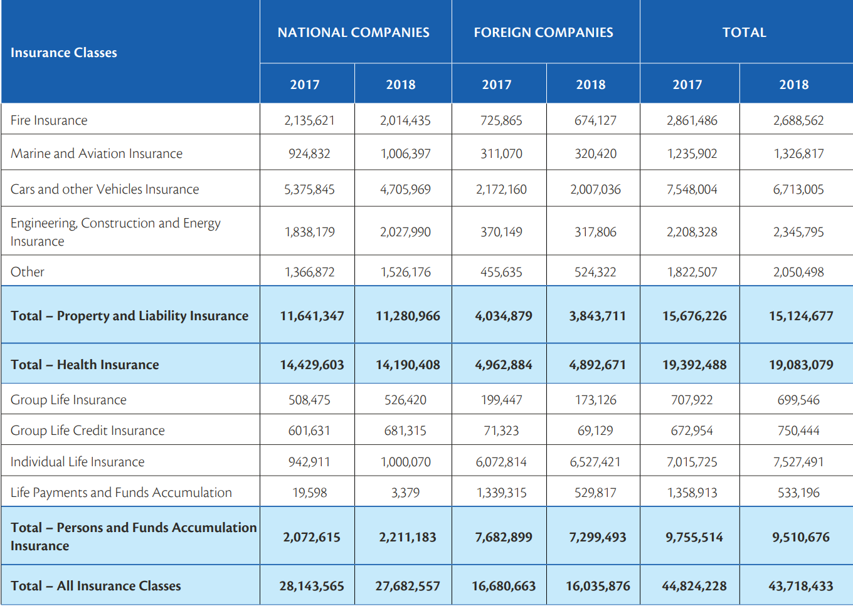
Statistics:

Slide 5
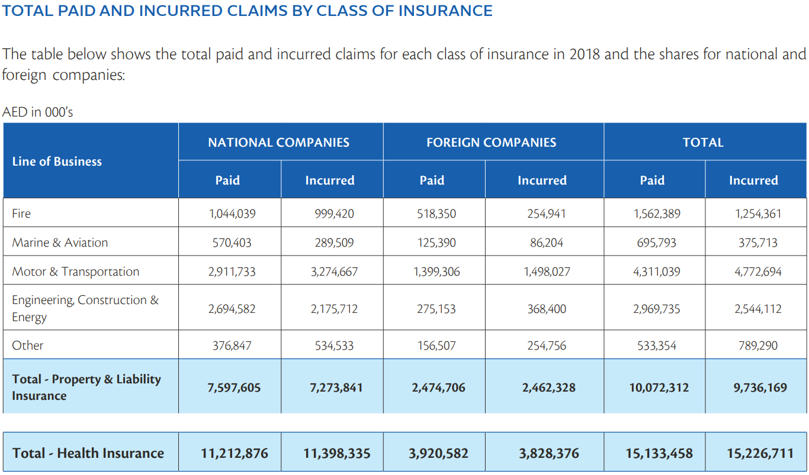
Statistics:

Slide 6
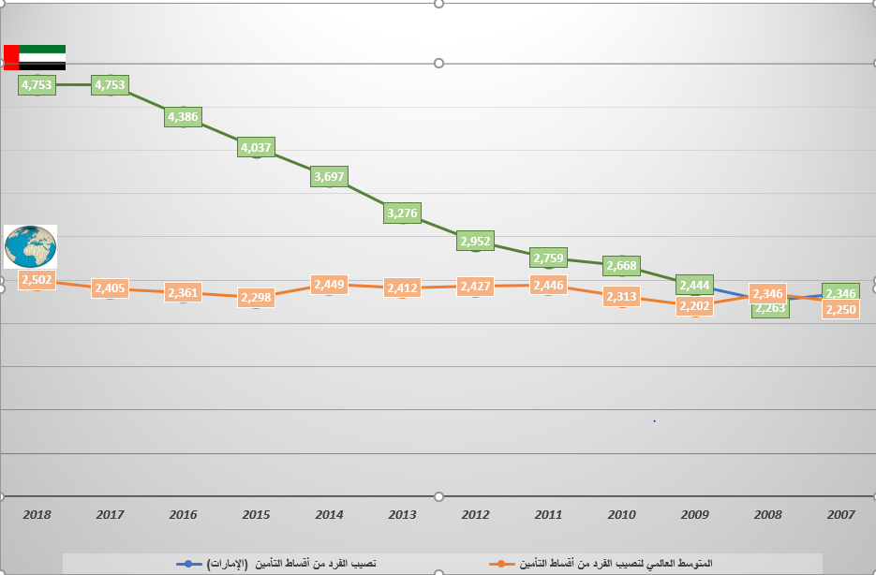
Individual's share of premium in comparison with global average from 2007-2018

Slide 7
Current Medical Insurance schemes:
Abu Dhabi
Health insurance for citizen.
Through the”Thiqa – Trust” Program, the Government of Abu Dhabi provides comprehensive medical coverage to all UAE nationals residing in Abu Dhabi, and Daman provides cards of trust to all Emiratis residing in Abu Dhabi. These cards provide treatment in a large number of public and private health care facilities included in the National Health Insurance Company's network of work, cover more geographical coverage and provide additional medical benefits.
Eligible to join the Trust Program, citizens residing in Abu Dhabi between the ages of 18 and 75 are eligible to undergo a "prevention" screening programm administered by the Department of Health - Abu Dhabi. A medical examination is conducted to determine the factors causing heart disease and is only exempted in exceptional circumstances.
As of July 1, 2016, The Abu Dhabi Health Authority has implemented amendments to health insurance programs that address both the Trust program and the Abu Dhabi Basic Program. These amendments to the use of the health insurance system are intended to increase overall efficiency across the sector in order to meet current and future requirements.

Slide 8
Current Medical Insurance schemes:
Dubai
“Saada – Happiness” is the Health Insurance Program for Citizens of Dubai and aims to provide insurance coverage to citizens who do not currently benefit from any other government health program affiliated with the Emirate. The program provides medical and health services within a wide network of healthcare providers in the private sector, as well as services they receive at DHA health centres.
Saada relied on the use of an ID card instead of a recognized insurance card to register and benefit from all the benefits of the program.

Slide 9
Current Medical Insurance schemes:
Ajman
The Ajman government provides all its employees with the advantage of health insurance. A list of hospitals, clinics and pharmacies accredited by the health insurance network can be obtained through the website and payment forms can be downloaded.

Slide 10
Current challenges:
Too many carriers:
(50) Carriers (life, Non-life & Composite).
Fierce competition.
Reflections on pricing.
However,
Upon conclusion of the Medical Insurance schemes in the Northern Emirates, the Med portfolio should benefit from the large number that are a going to added in, which will provide more stability.
IA still believes that Insurance companies need to consider other option such as mergers and other acquisitions.

Slide 11
Current challenges:
Moral Hazard/ Unauthentic claims:
False med bills.
False description of med condition leading to unnecessary treatment.
Using more than one cover for the same condition.
Attempts to acquire treatment for excluded risks.
Other cases, such as substituting drug prescriptions with cosmetics.

Slide 12
We can over overcome the challenges if we adopt:
Digitalization

Slide 13

Getting on board/ IA’s Sand Box:
The Insurance Authority Board of Directors’ Decision No. (41) of 2019 Concerning the Supervisory Rules for the Experimental Environment of Financial Technology in the Insurance Industry.

Slide 14
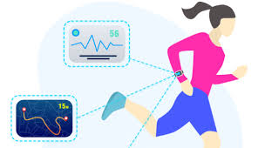
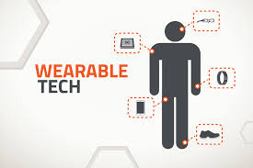
Riding the wave:
Using wearables:
Better risk management.
Better pricing.
Better claims handeling.
Change in the whole life style of the Insured which leads to better health and lower risk.
Challenges:
Using wearables should be transparent about privacy, including what information is captured, stored and shared, and how the data is used.
Obtain prior written consent and the appropriate authorization from their customers before accessing their personal information.
Anti-selection issues.

Slide 15


Riding the wave:
Big Data and big data analytics:
Enhance Competitiveness.
Pricing.
Cross selling.
Claims prediction – fraud detection.
Consumer choice – Tailored.

Slide 16
Riding the wave:
Internet of things (IoT):
Devices communicating.
Hydration levels.
smart wallets that track prescription pills, weather they have been removed from bottle and can send reminders to smartphones
Behavior monitoring.
Availability of real-time information( ie: Intelligent nutritional platforms).

Slide 17

Join the IA’s Sand Box

Slide 18
Thank you for listening

